Slide 1
Intro to Artificial Intelligence

Slide 2
Group Members
Muhammad Taqui
(01-136221-021)
Abdul Basit
(01-136221-049)
Muhammad Talha
(01-136221-055)
Muhammad Waleed
(01-136221-060)

Slide 3
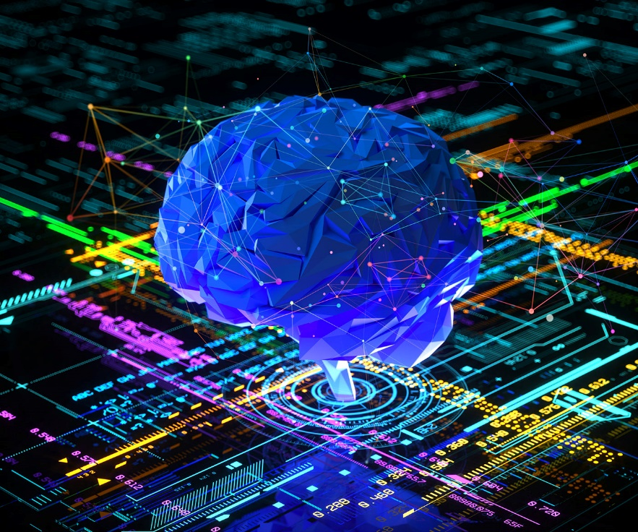
What is AI
Artificial intelligence is a technology that enables a computer to think or act in a more human way . It does this by taking information from it's surroundings and deciding its response based on what it learns or sense .

Slide 4
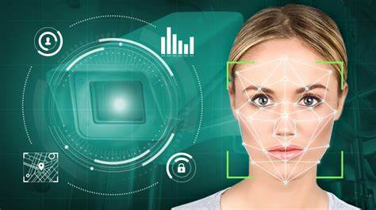
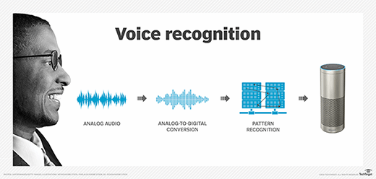
Achievements of AI
AI-induced Face Recognition
Drug Discovery
Speech Recognition
COVID-19 Detection in Lungs by AI

Slide 5
Advantages of AI
Reduce human errors and perform various tasks with greater efficiency by using intelligent systems.
With the help of artificial intelligence technology one can develop digital assistants that reduce manpower.
Lot of applications have been developed using artificial intelligence. iPhones Siri and Microsofts Cortana developed on the phenomenon of artificial intelligence.

Slide 6
Disadvantages of AI
Artificial intelligence is slowly making its way into real-time applications. AI offers great prospects but it’s really expensive.
Artificial intelligent systems might replace humans in performing a task in terms of productivity, but they can’t make decisions.
Replacing humans with intelligent systems might increase unemployment that lead to poor GDP.

Slide 7
Goals of AI
Artificial planning helps agents sequence actions to perform to achieve goals.
Artificial intelligence’s main goal is to develop intelligent machines that could learn on their own. No more human intervention for feeding data to machines.
Develop systems that can recognize, interpret, process and simulate human affects.

Slide 8

That’s all guys.

